Slide 1
SPOTIFY ANALYSIS USING TABLEAU
Presented by
Rebbufred RJ

Slide 2






Excel CSV format
Data Sources Used
Summary of analysis
Top 3 recommendations
01
02
03
04
05
06
Business Task
Documentation
Visualizations
To utilize Tableau’s data visualization capabilities and present insights

Slide 3
Cleaning and manipulation of data
Date formatting
Internally stored
Time series analysis
Geographical analysis
It was in a format that won’t allow trim function to be used. Changed that
Created a line and trend chart and analyzed the trends of a particular field. The date formatting helped.
The date were stored in internal serial number. Had to change that
Created a map visualization that helps in getting geographic insights on various artists. Added a filter on the country visual so that we can drill down into each country

Slide 4
Summary of the analysis
Trend analysis
Artist by streams
Future trend prediction
Percentage Contribution
Even though the whole trend is in downtrend, we can see the increase in the streams.
The top 10 artists show a heavy recovery in their streams except Drake shows a downtrend
Ed Sheeran, Post Malone and Drake tops the list in more than 90% of the country
The top 10 tracks irrespective of the artists accounts for 67% of the total share.

Slide 5
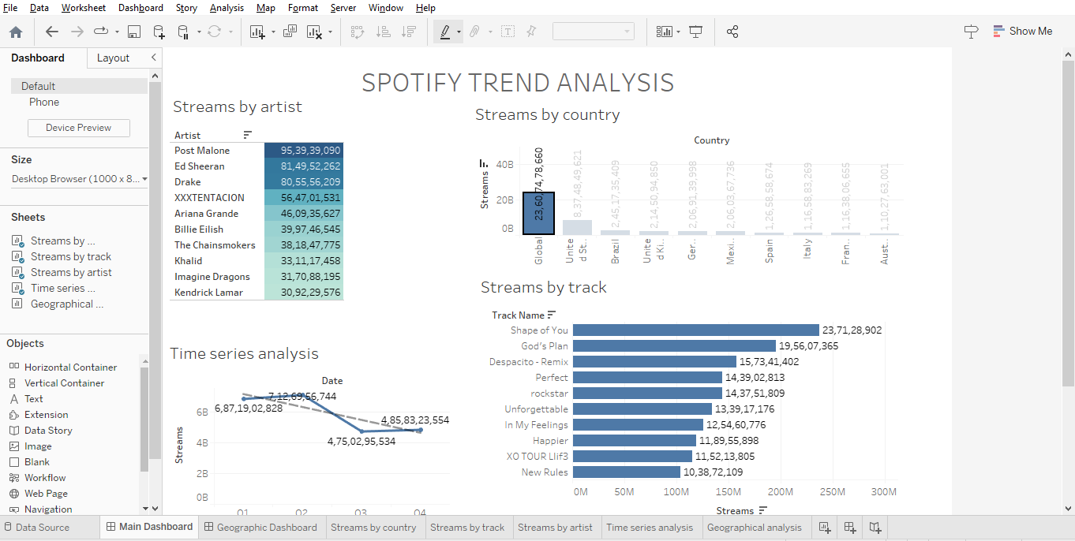
Visualization (through Tableau)

Slide 6
Top 3 recommendations
Focus towards Post Malone
Geographic segmentation
Focusing on CSR
Post Malone is in 4th position in top 10 most streamed songs and he has only one song in the top 10. So, writing an algorithm to push Post Malone’s other songs to the target audience will gain more customer retention
By promoting non vulgar songs to the youth would make an impact and also helps in adding contribution to the society.
Other than US, Ed Sheeran tops in all the top 10 countries that brings maximum revenue. So, by targeting the songs of Ed Sheeran to the targeted audience will gain more traction in the stream

Slide 7
THANK YOU

